Slide 1
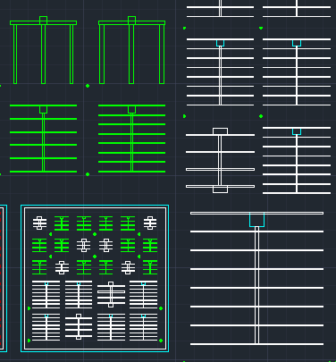
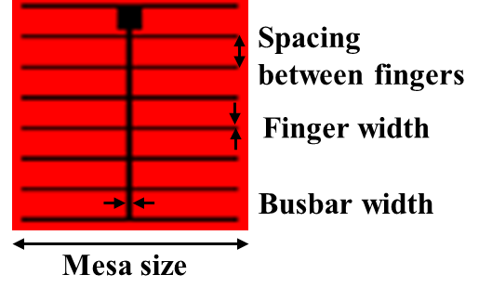
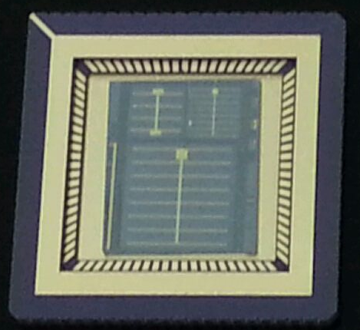
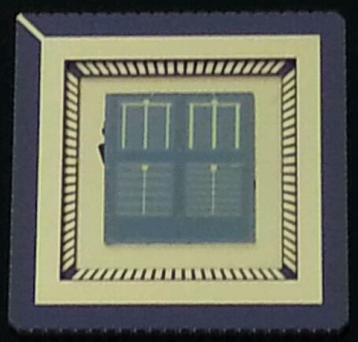
n-i-n Heterojunction Structure
n⁺-GaAs cap
(2E18, 30 nm)
5
4
Al_{0.3}Ga_{0.7}As barrier
(undpoed, 500 nm)
7
6
3
2
n⁺-GaAs buffer
(2E18, 300 nm)
1
n⁺-GaAs (substrate) 350 um
Top contact
Ohmic metal contact
Bottom contact
# | Mesa size (mm) | Spacing between fingers (μm) | Finger width (μm) | Busbar width (μm)
1 | 10 | 1170 | 100 | 200
2 | 5 | 590 | 50 | 100
3 | 5 | 1070 | 100 | 200
4 | 5 | 1720 | 300 | 200
5 | 5 | 1720 | 200 | 200
6 | 5 | 590 | 50 | 100
7 | 5 | 840 | 50 | 100
1

Slide 2
I-V Characteristics @ room temperature
I-V curves on linear scale
I-V curves on semilog scale
*Current Compliance Limit: 10 mA
2

